Slide 1


Git Branch
Presented by: Group 3

Slide 2
What is a Branch?
A Branch represents an independent line of development.
Git Branches are effectively a pointer to a snapshot of our changes.
By default the branch name is called ‘main’ previously known as ‘master’ .
We can create as many branches as we want, merge them or delete.
In Git, Branches are a part of our everyday development process.
.

Slide 3

Fig: Branching and Merging

Slide 4
Why we use branch?
Case1:
Issue fixing without polluting stable version.
Merge is required after solution is fixed.
Case2:
Creating d/f product lines for various platforms,customers, etc.
Merge may or may not required.

Slide 5
Basic Git Commands For Branching
List all the branches
git branch
Create a new branch
git branch <new_branch>
Delete a branch
git branch -d <branch name>
Checkout to a new branch
git checkout <branch name>
Create a new branch and checkout to it
git checkout -b <new_branch>

Slide 6
Switch to the branch last checked out
git checkout
List all branches(Local and remote)
git branch -a
Merge a branch into the active branch
git merge [branch name]

Slide 7
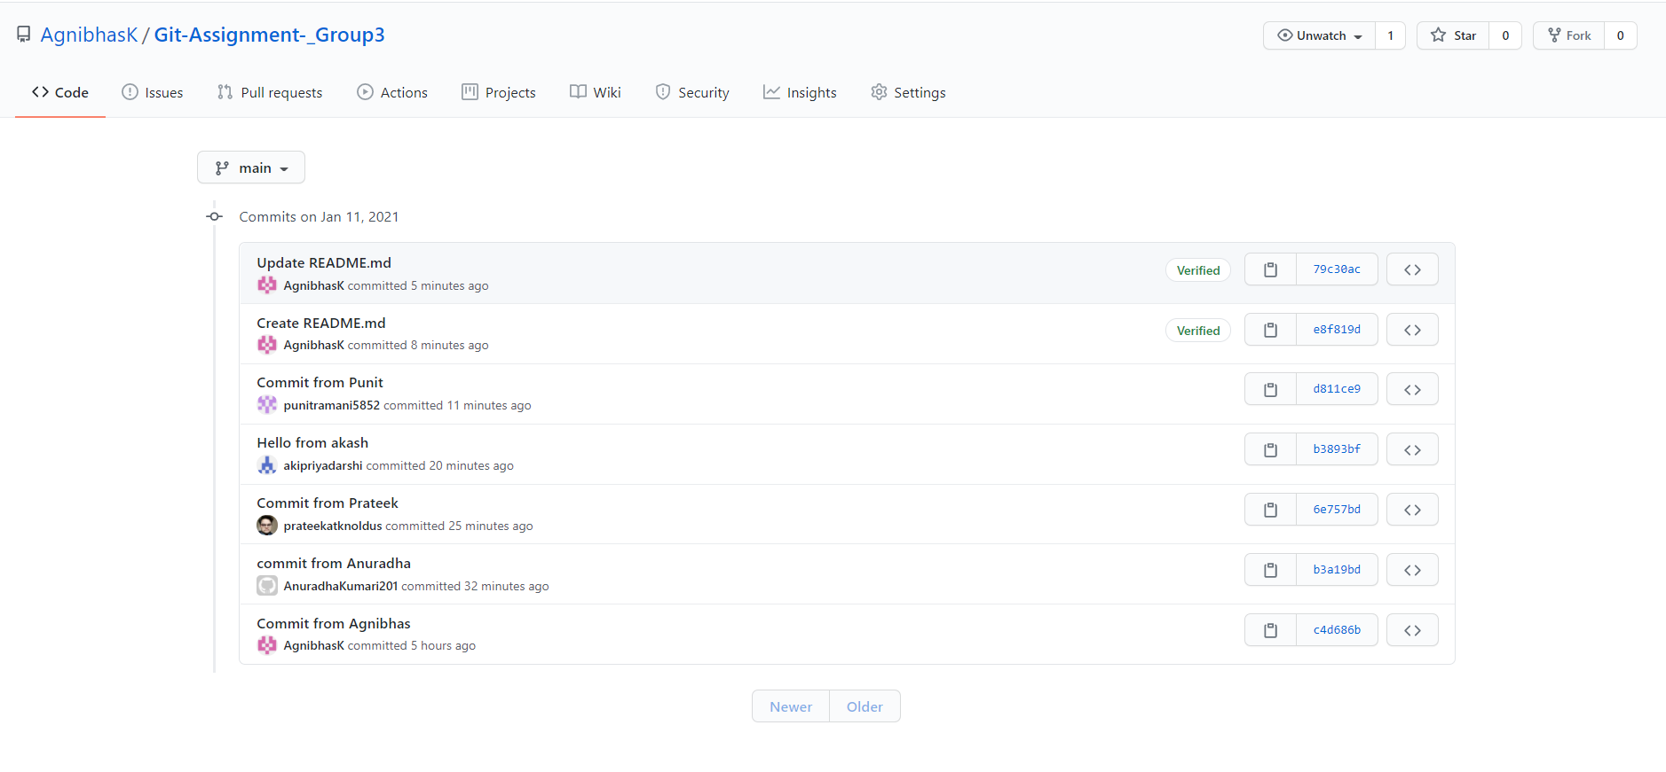
Commits by all team members
Link: https://github.com/AgnibhasK/Git-Assignment-_Group3.git

Slide 8
What did we learn ?
Introduction to Branches in Git.
Diagrammatic representation of how branches work ?
How branches are useful ?
Basic Git commands and their applications.
Collaborated on a public repository as a team.

Slide 9
Group 3 Members
1. Punit Ramani - punit.ramani@knoldus.com
2. Akash Priyadarshi - akash.priyadarshi@knoldus.com
3. Prateek Gupta - prateek.gupta@knoldus.com
4. Agnibhas Chattopadhyay - agnibhas.chattopadhyay@knoldus.com
5. Anuradha Kumari - anuradha.kumari@knoldus.com

Slide 10


